Slide 1
Android Market and App Business Issues
Android How to Program
Week 2
©1992-2013 by Pearson Education, Inc. All Rights Reserved.

Slide 2
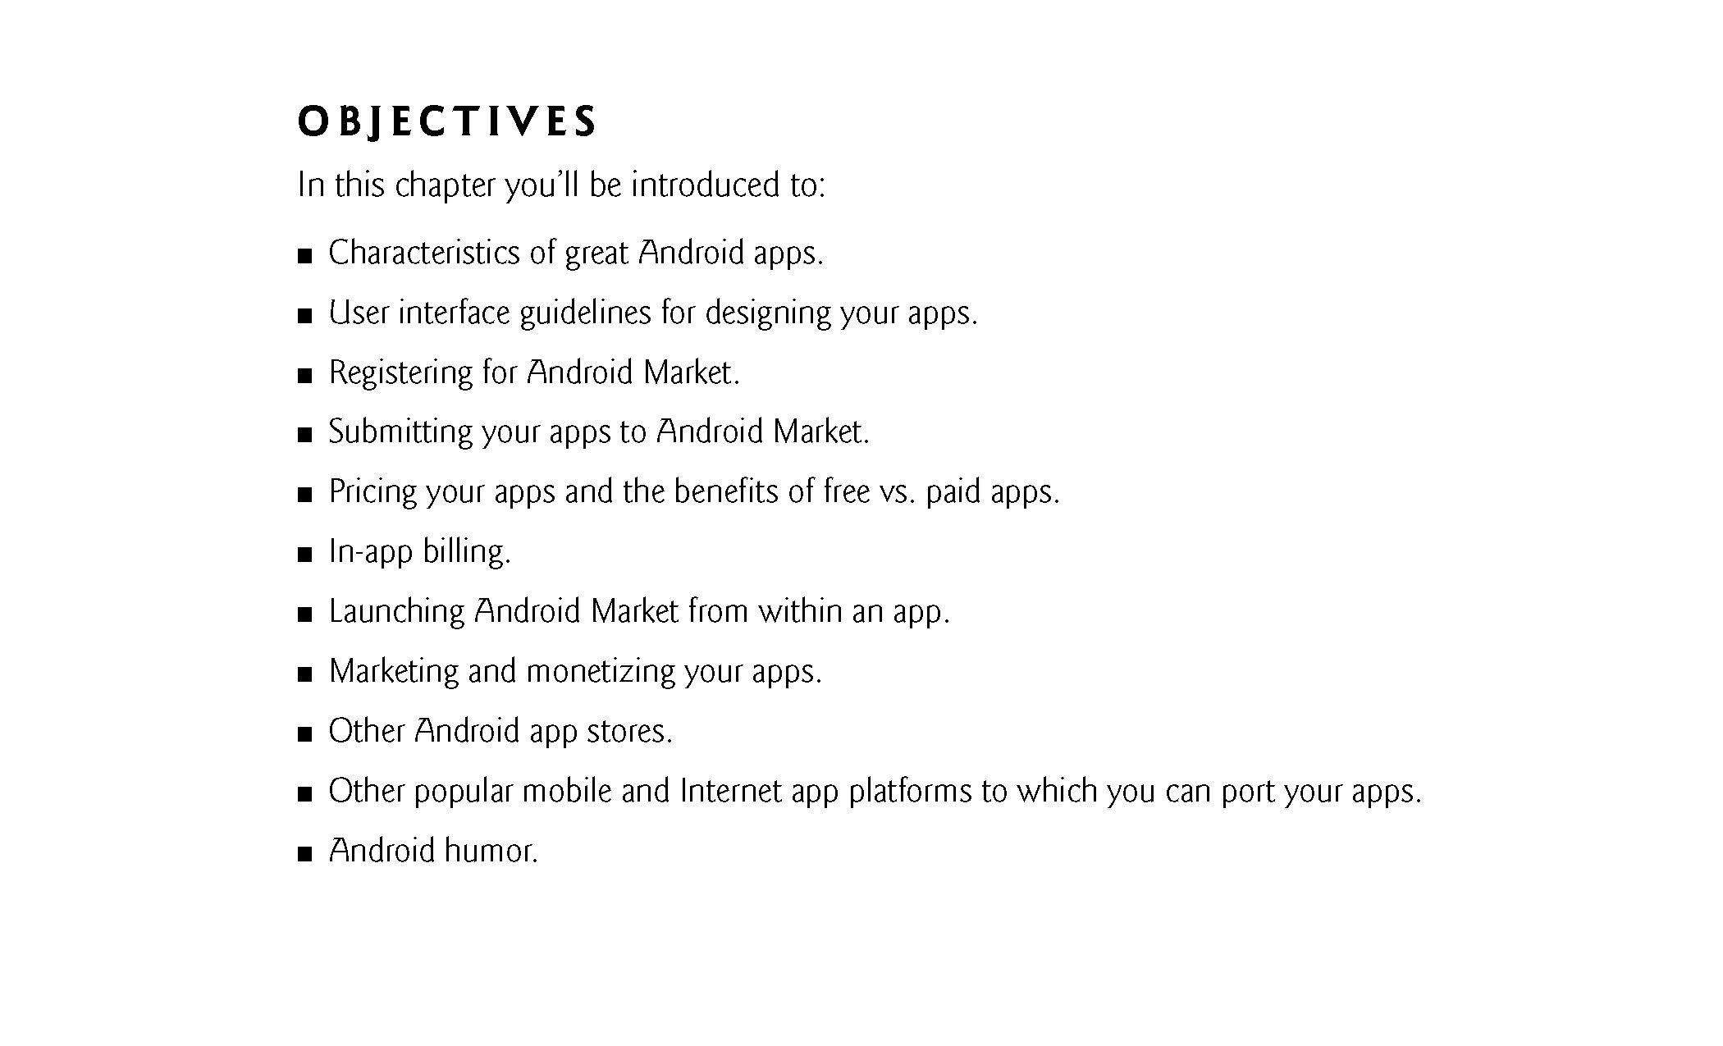
©1992-2013 by Pearson Education, Inc. All Rights Reserved.

Slide 3
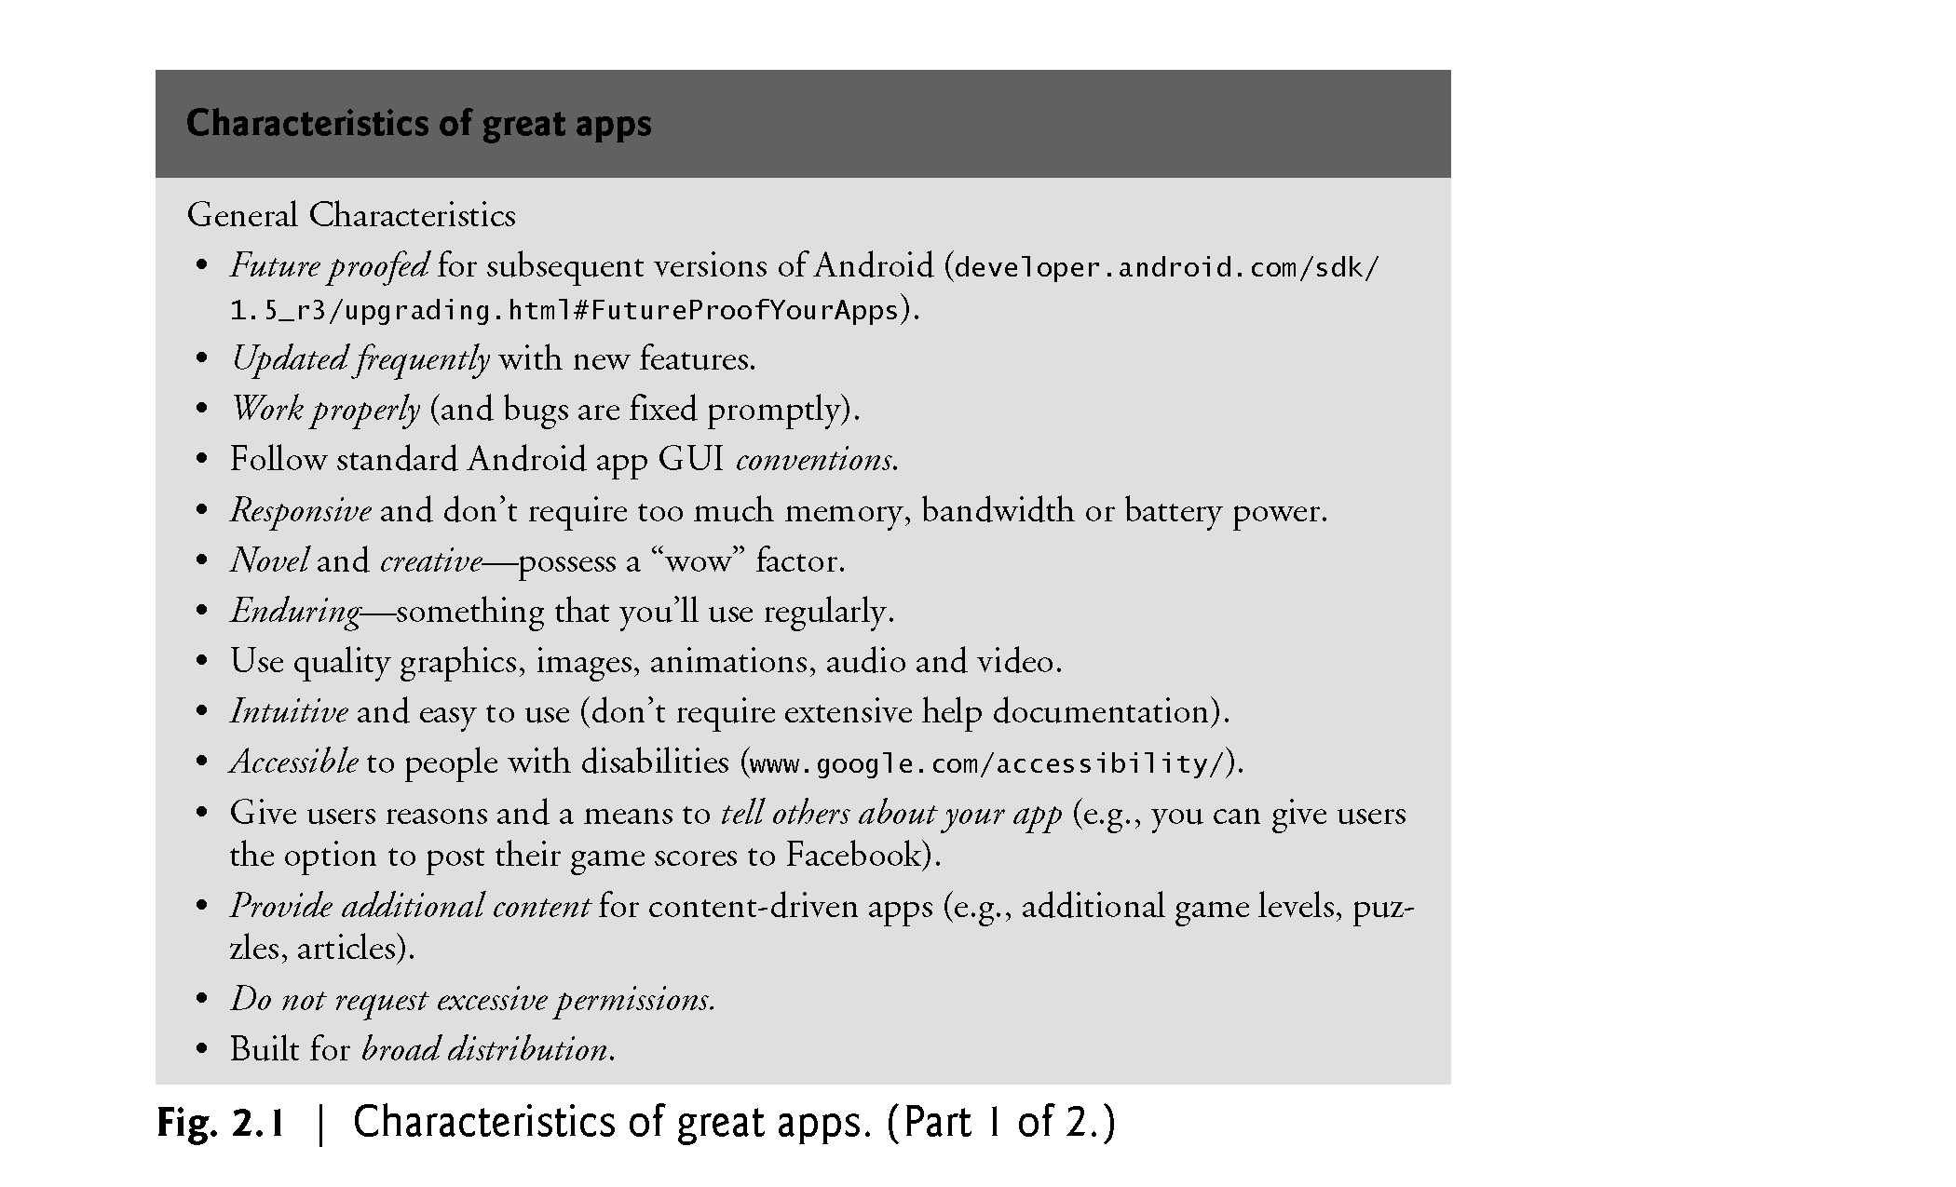
Characteristics of great Apps
©1992-2013 by Pearson Education, Inc. All Rights Reserved.

Slide 4
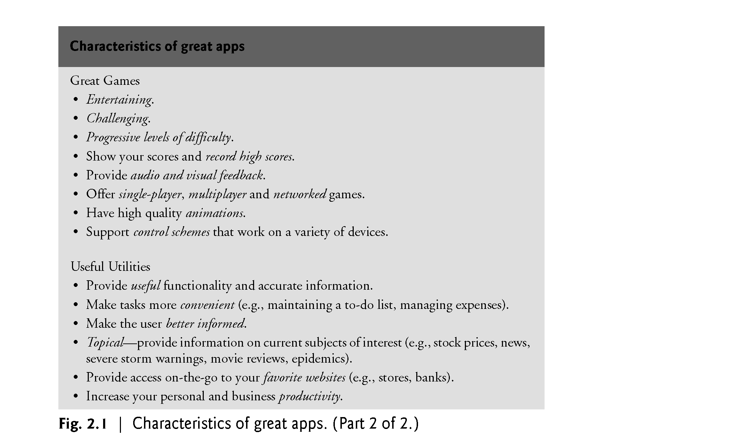
Characteristics of great Apps
©1992-2013 by Pearson Education, Inc. All Rights Reserved.

Slide 5
Android best practices
Compatibility
<uses-feature> elements lists in your app’s manifest file describe the app’s feature needs.
The list above is used to filter the app that only users with compatible devices can view and download it.
For example, if your app does not make sense on a device that lacks a compass sensor, you can declare the compass sensor as required with the following manifest tag:
<manifest ... >
<uses-feature android:name="android.hardware.sensor.compass"
android:required="true" />
...
</manifest>
©1992-2013 by Pearson Education, Inc. All Rights Reserved.

Slide 6
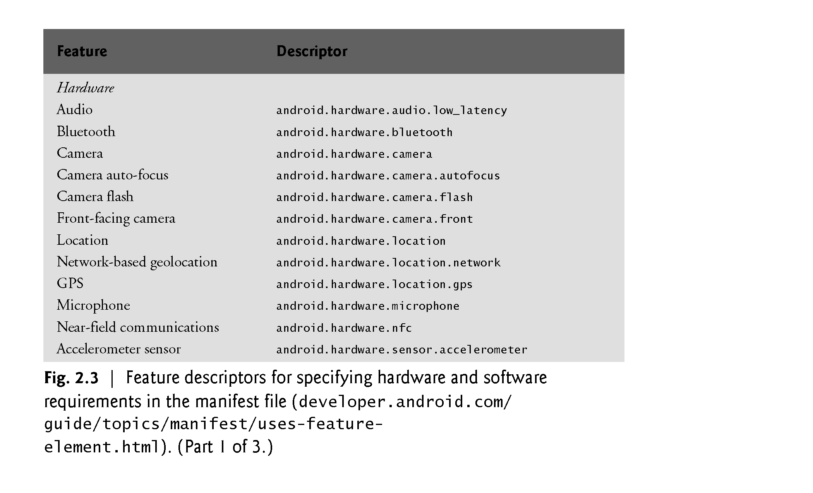
Feature descriptors
©1992-2013 by Pearson Education, Inc. All Rights Reserved.

Slide 7
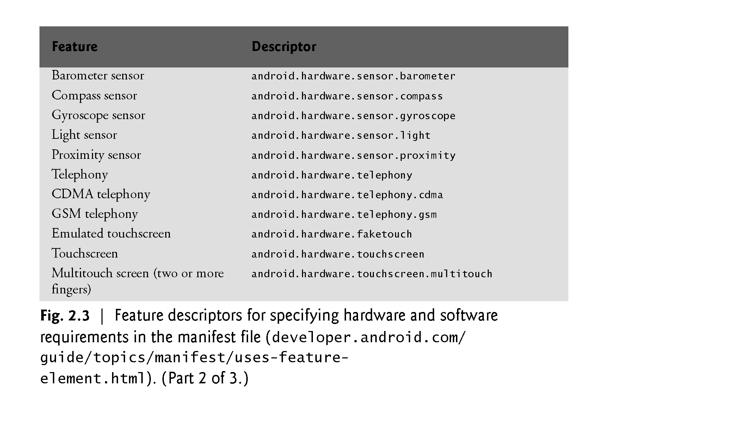
Feature descriptors
©1992-2013 by Pearson Education, Inc. All Rights Reserved.

Slide 8
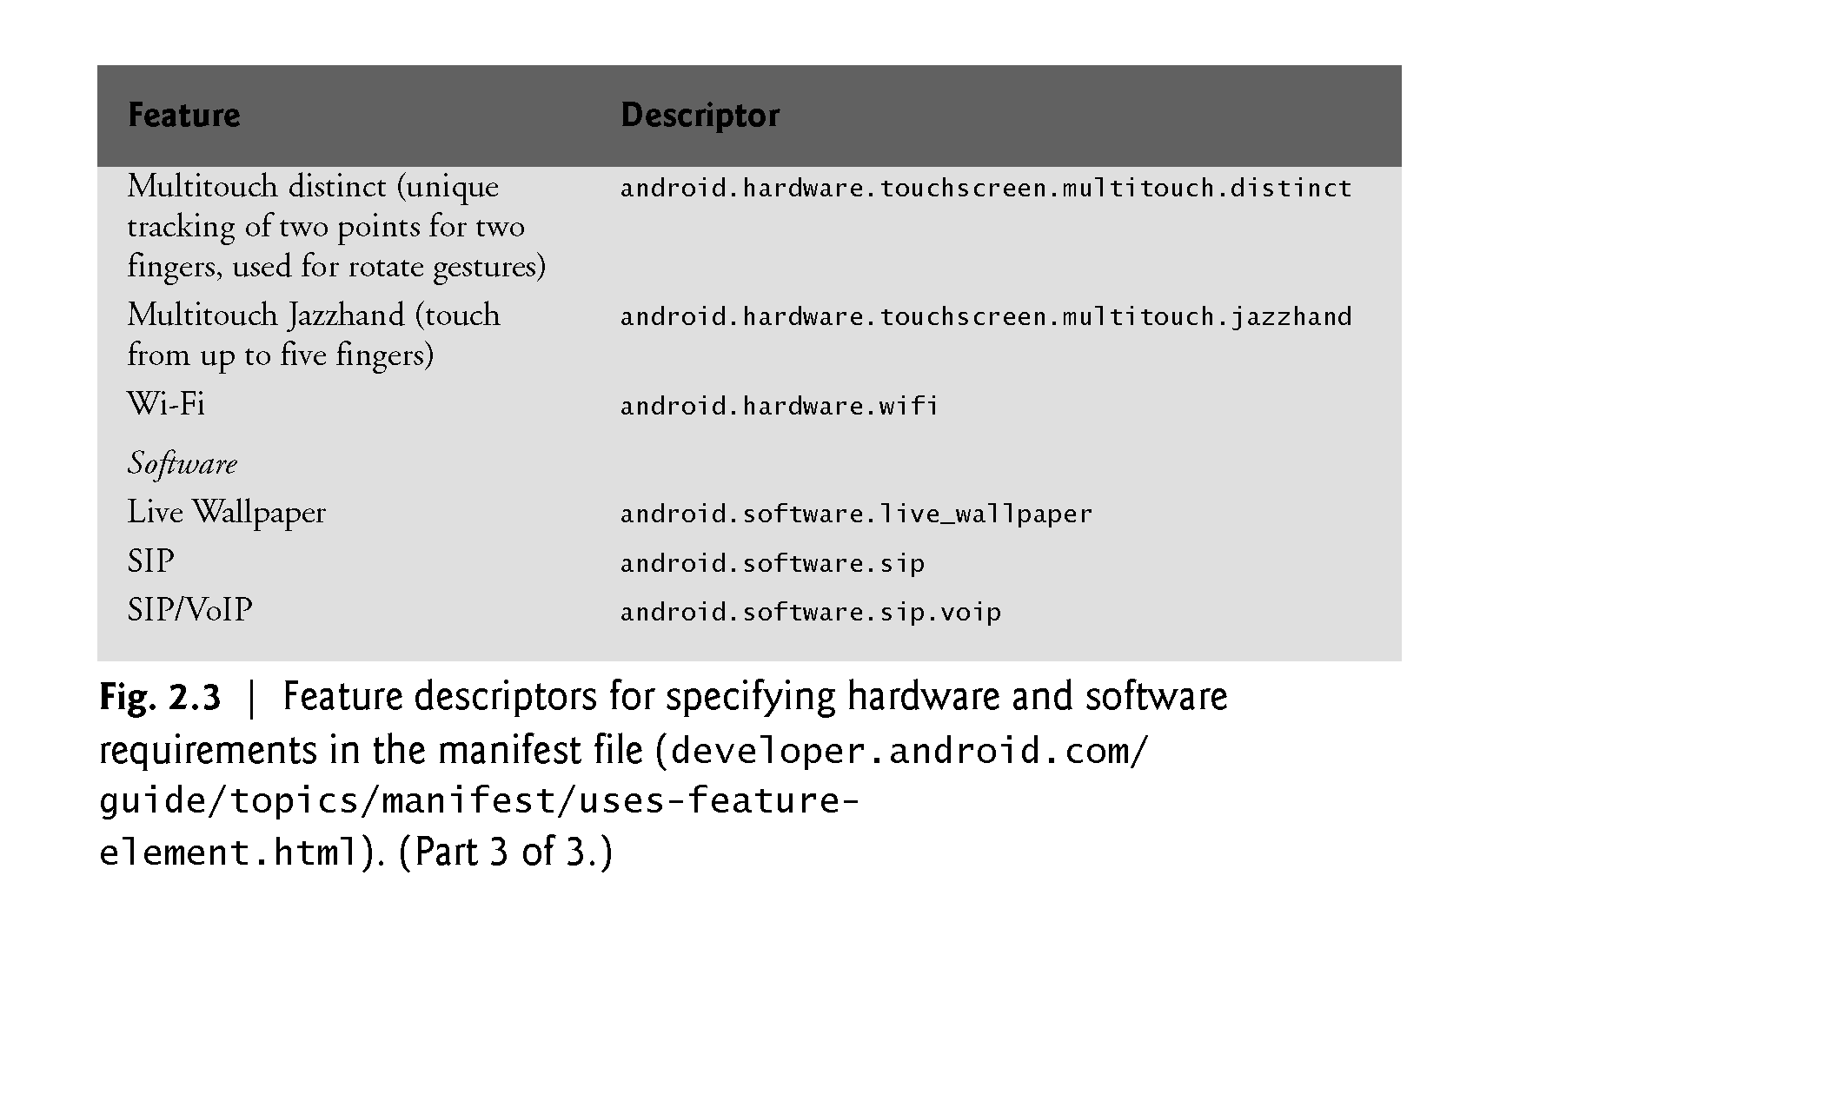
Feature descriptors
©1992-2013 by Pearson Education, Inc. All Rights Reserved.

Slide 9
Android best practices
Supporting Multiple Screens
Android SDK 1.6 and higher support multiple screen sizes and screen densities on different devices.
Android defines two characteristics for each device: screen size (the physical size of the screen) and screen density (the physical density of the pixels on the screen, known as DPI).
Four generalized sizes: small, normal, large, and xlarge.
Generalized densities: mdpi (medium), hdpi (hdpi), xhdpi (extra high), xxhdpi (extra-extra high), and others.
You can set the <supports-screen> element in the AndroidManifest.xml file to specify the screen sizes.
©1992-2013 by Pearson Education, Inc. All Rights Reserved.

Slide 10
Android best practices
Android User Interface Guidelines
Follow Android User Interface Guideline:
  http://developer.android.com/training/index.html
Best Practices for User Interface
Best Practices for Backgrounds jobs
Best Practices for performance
Improving Layout performance
Best practices for User Input
Building Apps with User info and Location
……….
©1992-2013 by Pearson Education, Inc. All Rights Reserved.

Slide 11
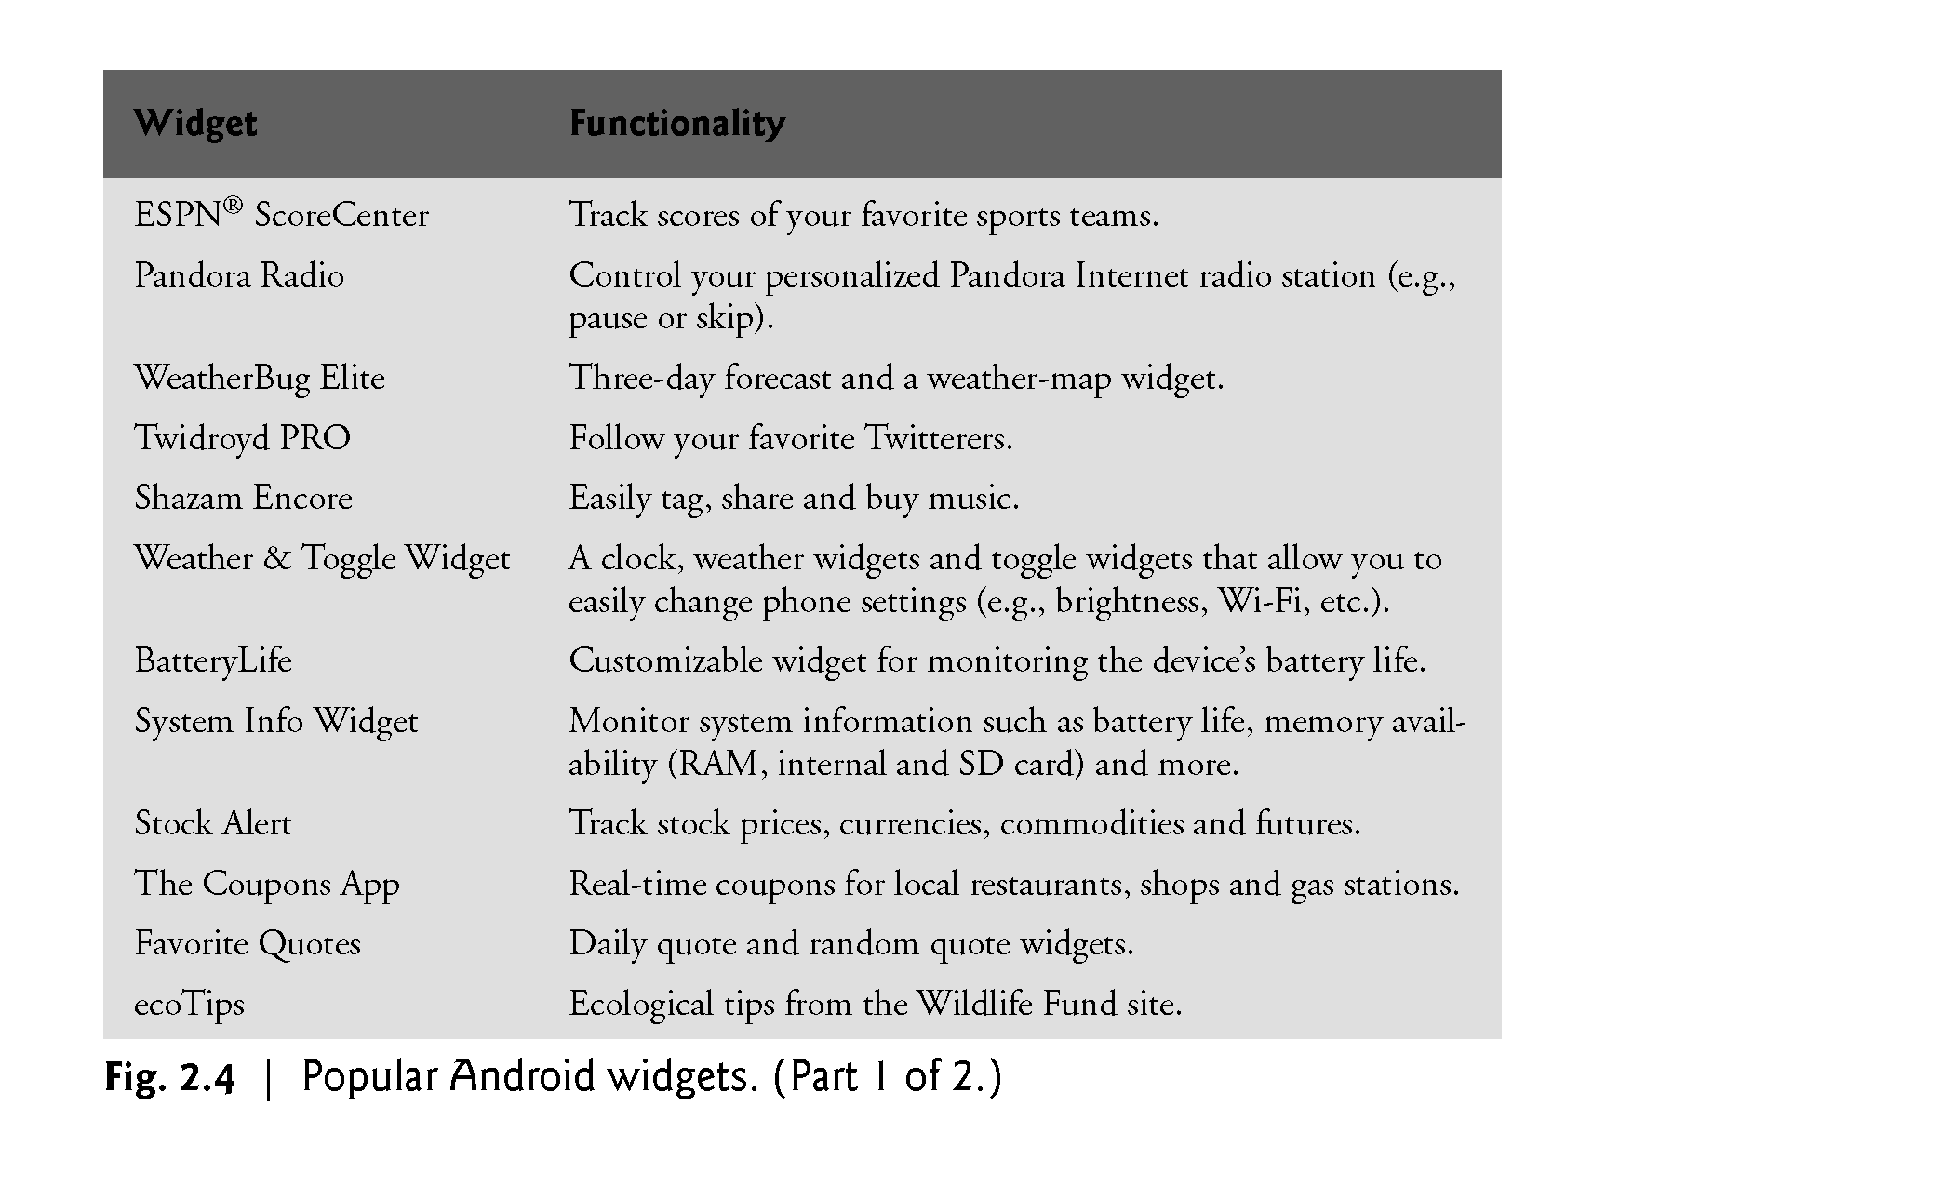
Popular Android Widgets
©1992-2013 by Pearson Education, Inc. All Rights Reserved.

Slide 12
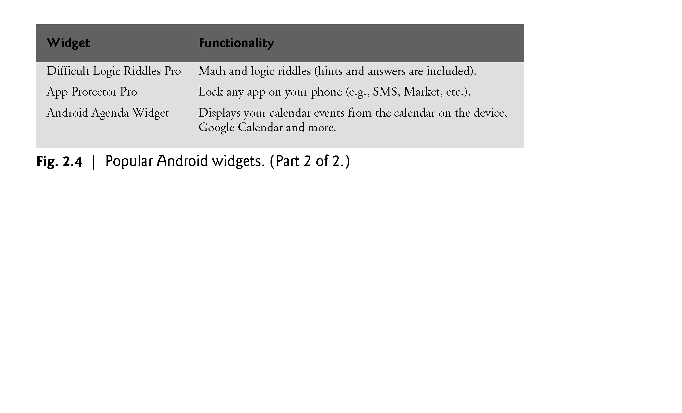
Popular Android Widgets
©1992-2013 by Pearson Education, Inc. All Rights Reserved.

Slide 13
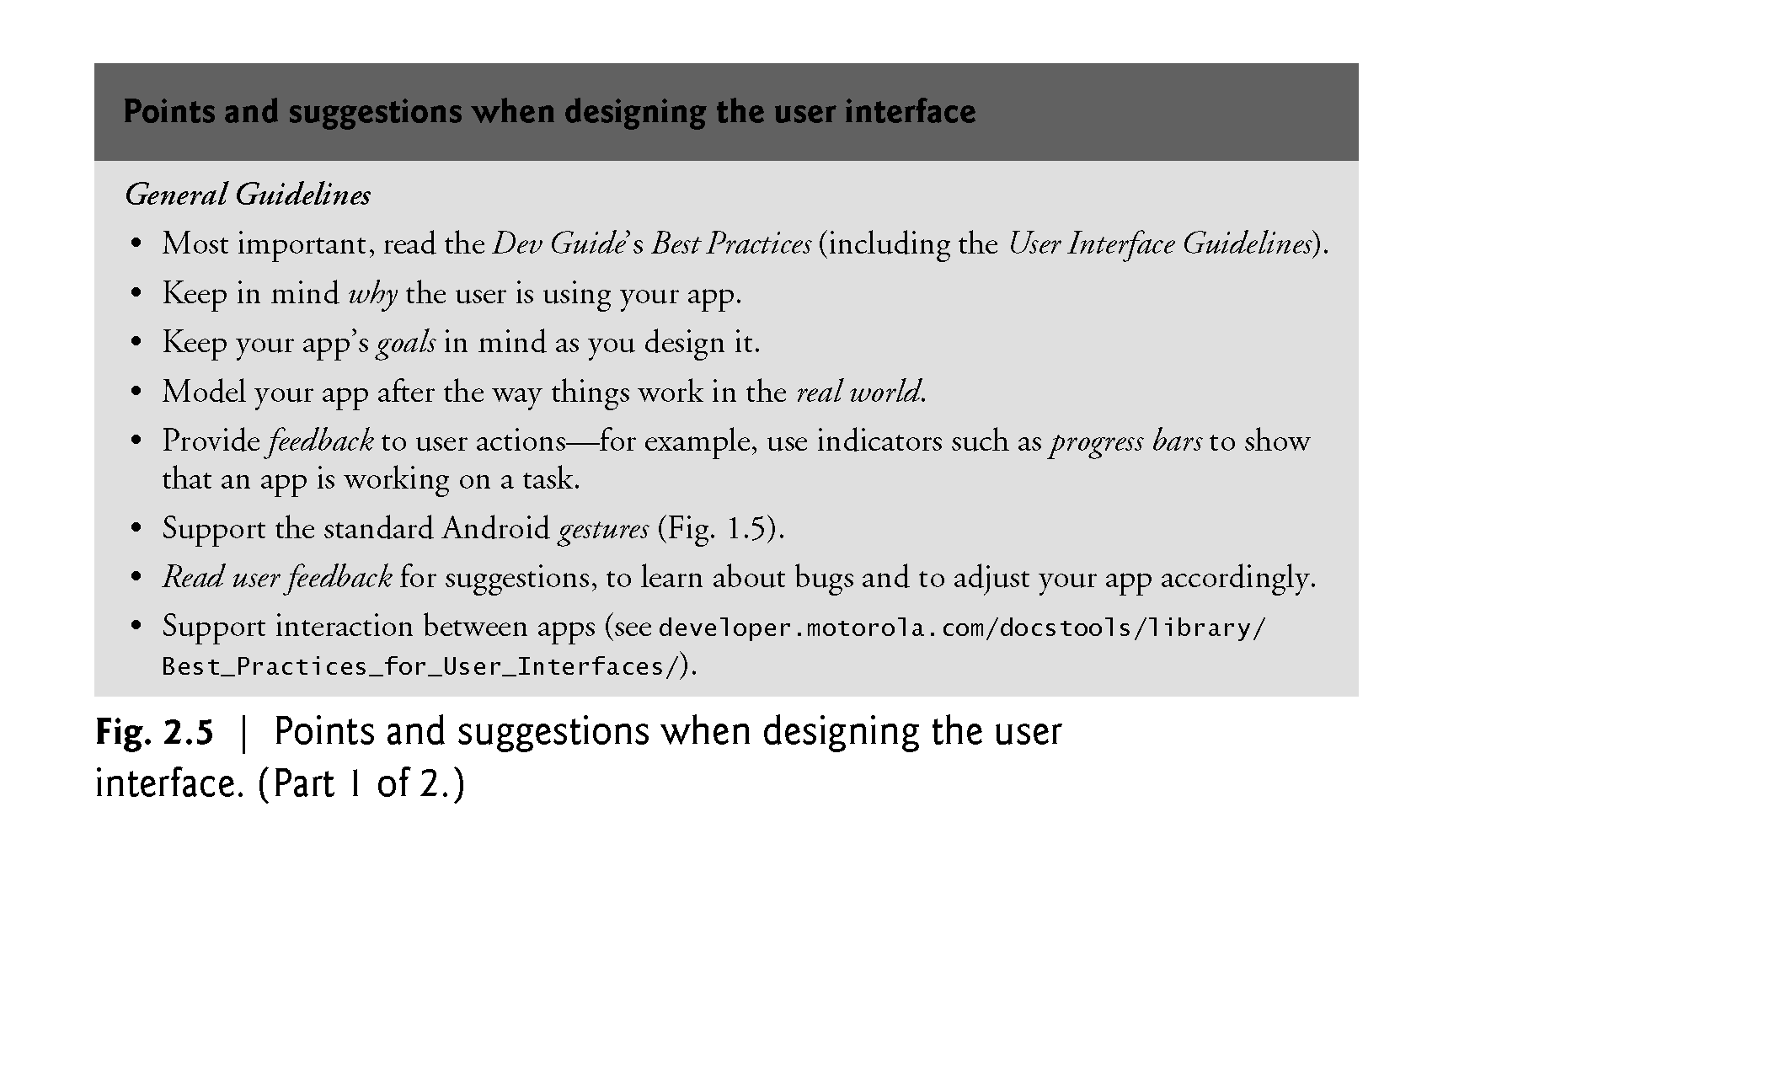
UI guidelines
©1992-2013 by Pearson Education, Inc. All Rights Reserved.

Slide 14
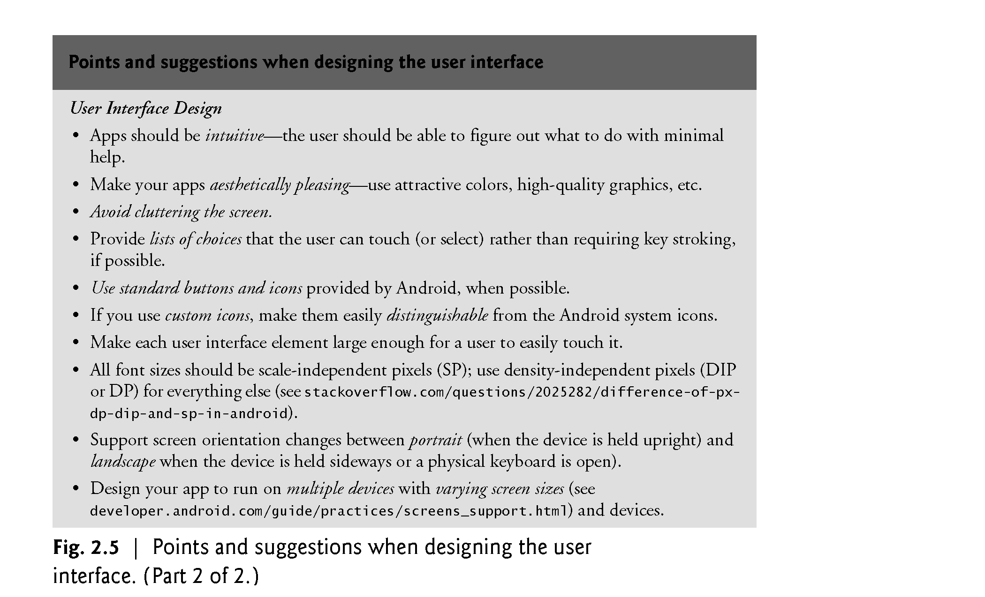
UI guidelines
©1992-2013 by Pearson Education, Inc. All Rights Reserved.

Slide 15
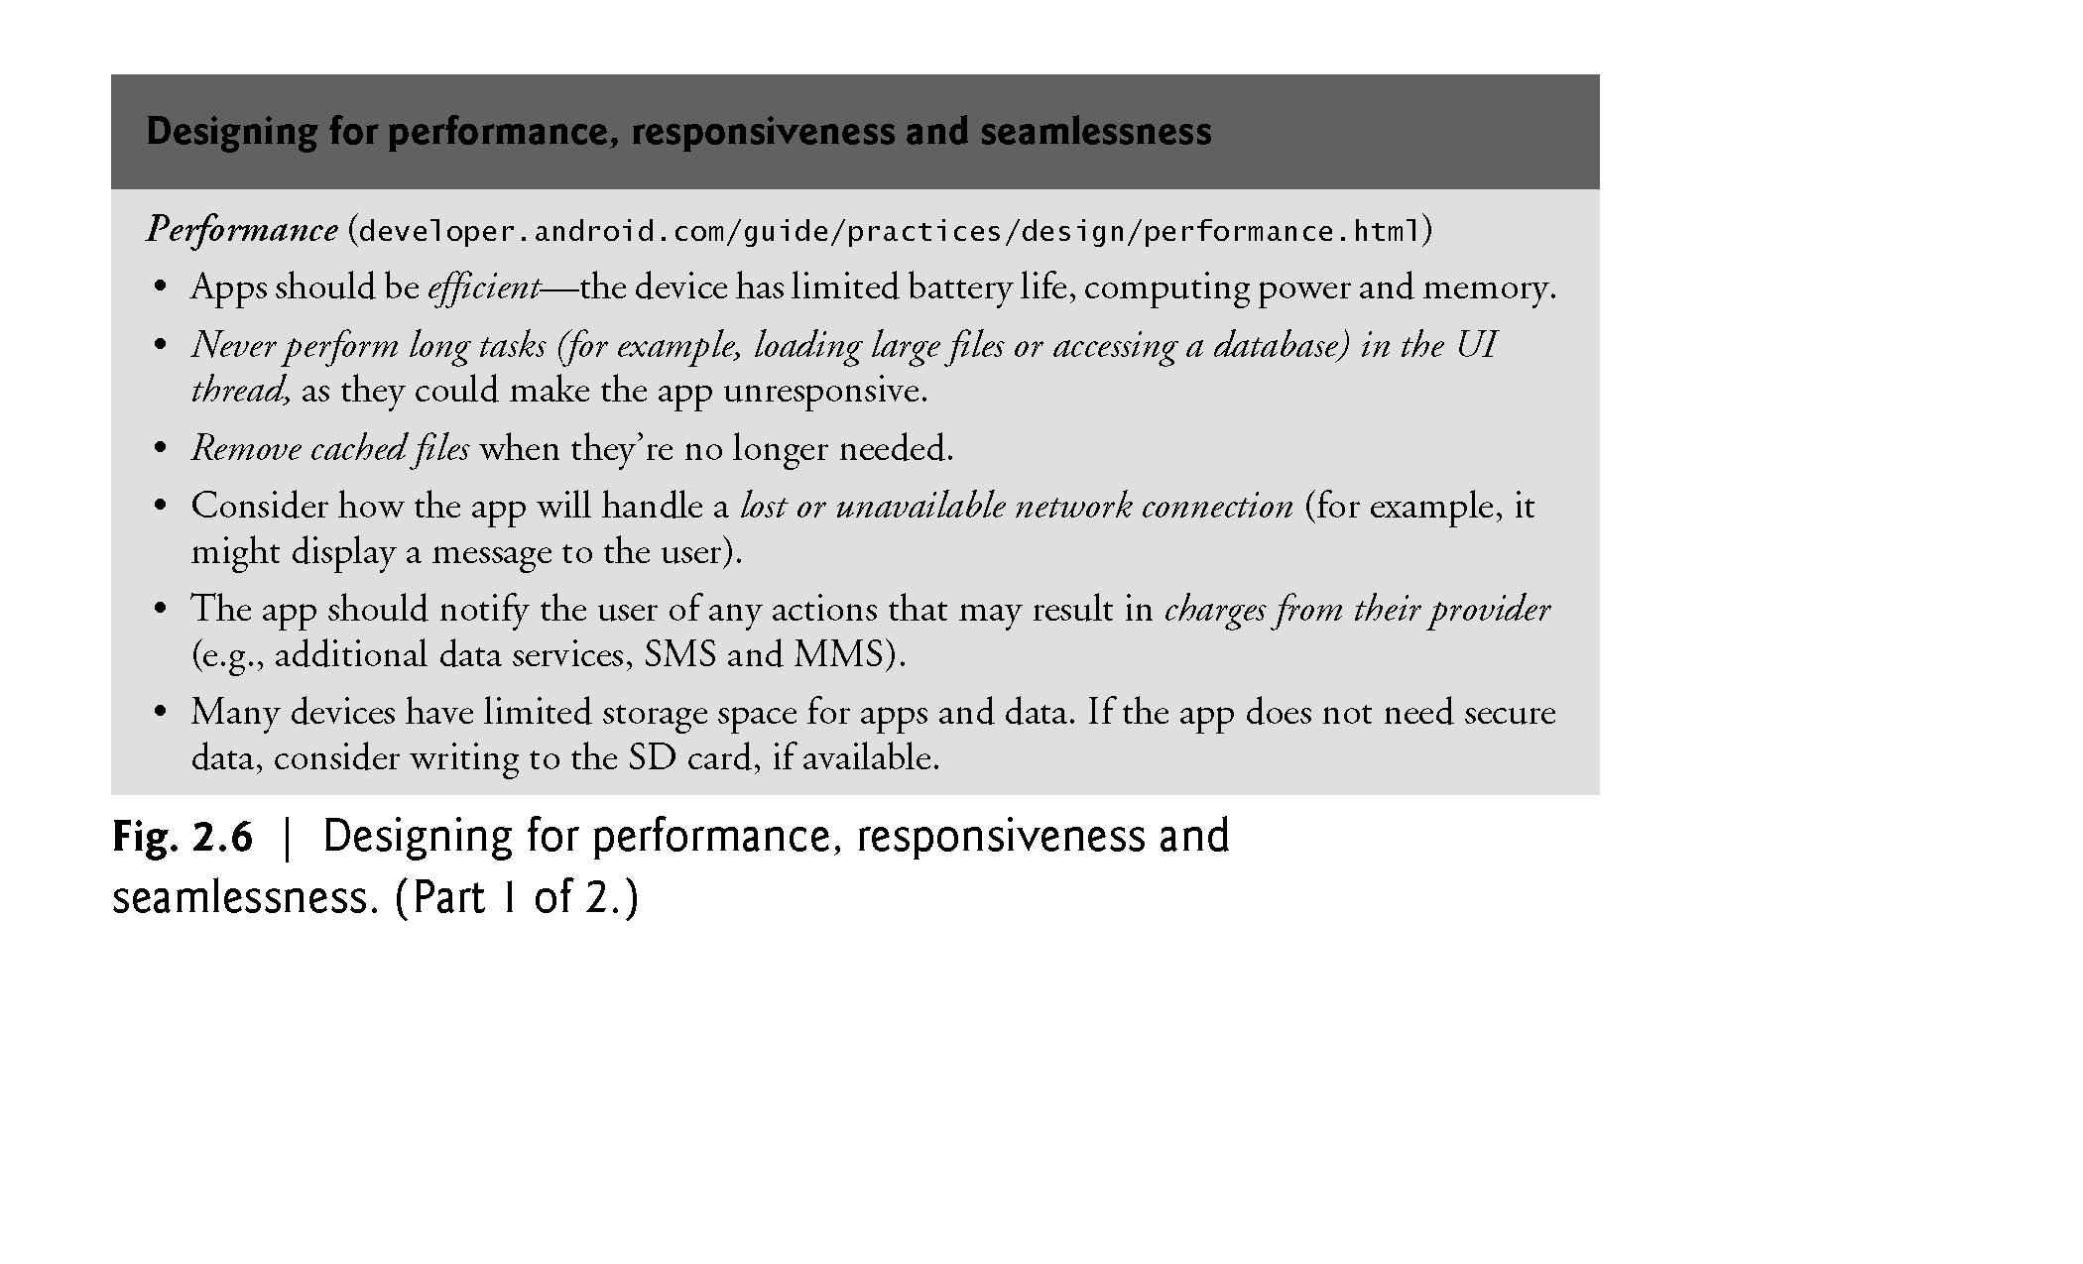
Performance guidelines
©1992-2013 by Pearson Education, Inc. All Rights Reserved.

Slide 16
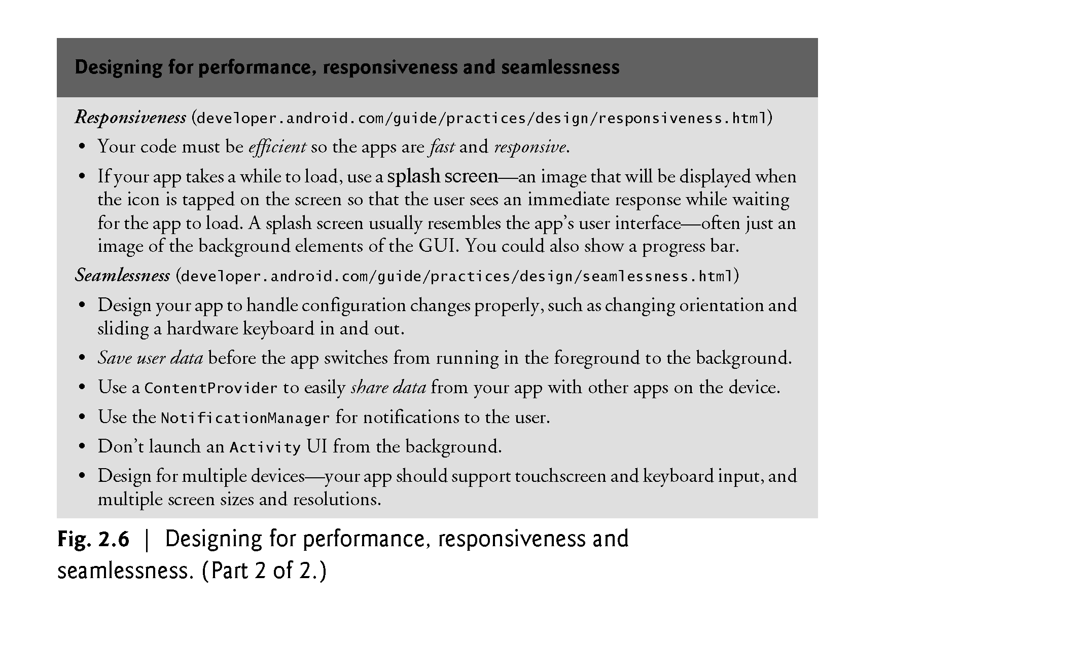
Performance guidelines
©1992-2013 by Pearson Education, Inc. All Rights Reserved.

Slide 17
Registering at Android Market
To publish apps on Android Market, you must register for an account
http://developer.android.com/distribute/googleplay/start.html
You should follow the Android market content policy for developer.
©1992-2013 by Pearson Education, Inc. All Rights Reserved.

Slide 18
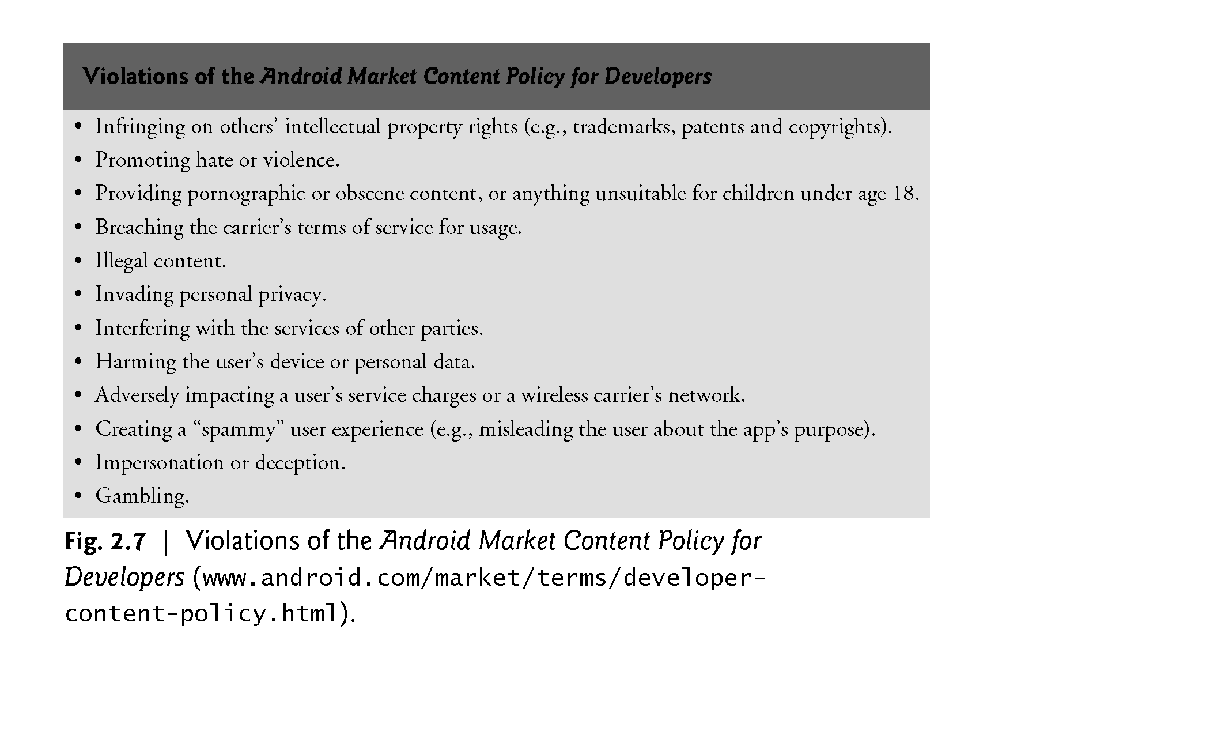
Violations of the Android Market Content Policy
©1992-2013 by Pearson Education, Inc. All Rights Reserved.

